Slide 1

Understanding React Native Context API
Master the power of Context API for efficient state management in your React Native applications. This presentation will guide you through implementation, best practices, and real-world examples.

Slide 2

What is Context API?
Definition
Purpose
Benefits
A built-in React feature that allows components to share data without prop drilling.
Creates a global state accessible to all components within a defined tree.
Simplifies component structure and improves code maintainability.

Slide 3





Problems Context API Solves
Prop Drilling
Eliminates passing props through multiple component levels.
Global State Access
Provides shared data to any component in the application.
Component Communication
Enables distant components to communicate efficiently.
Code Organization
Separates state logic from UI components.

Slide 4
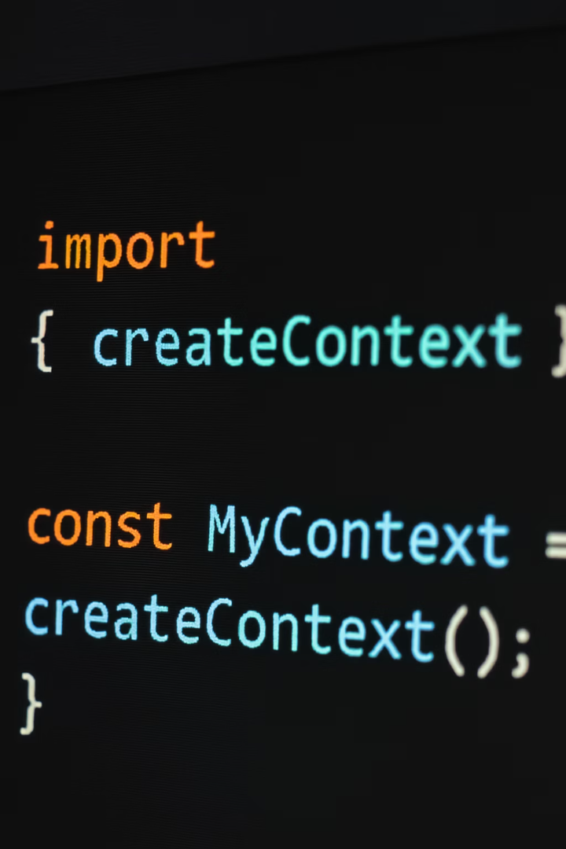
Step 1: Creating a Context
// AuthContext.js
import React, { createContext, useState } from 'react';
export const AuthContext = createContext();
export const AuthProvider = ({ children }) => {
const [user, setUser] = useState(null);
const login = (username) => {
setUser({ name: username });
};
const logout = () => {
setUser(null);
};
return (
<AuthContext.Provider value={{ user, login, logout }}>
{children}
</AuthContext.Provider>
);
};

Slide 5
Step 2: Providing Context
// App.js
import React from 'react';
import { AuthProvider } from './AuthContext';
import HomeScreen from './HomeScreen';
export default function App() {
return (
<AuthProvider>
<HomeScreen />
</AuthProvider>
);
}

Slide 6
Step 3: Consuming Context
// HomeScreen.js
import React, { useContext } from 'react';
import { View, Text, Button } from 'react-native';
import { AuthContext } from './AuthContext';
const HomeScreen = () => {
const { user, login, logout } = useContext(AuthContext);
return (
<View>
{user ? (
<>
<Text>Welcome, {user.name}!</Text>
<Button title="Logout" onPress={logout} />
</>
) : (
<Button title="Login as John" onPress={() => login('John')} />
)}
</View>
);
};
export default HomeScreen;

Slide 7
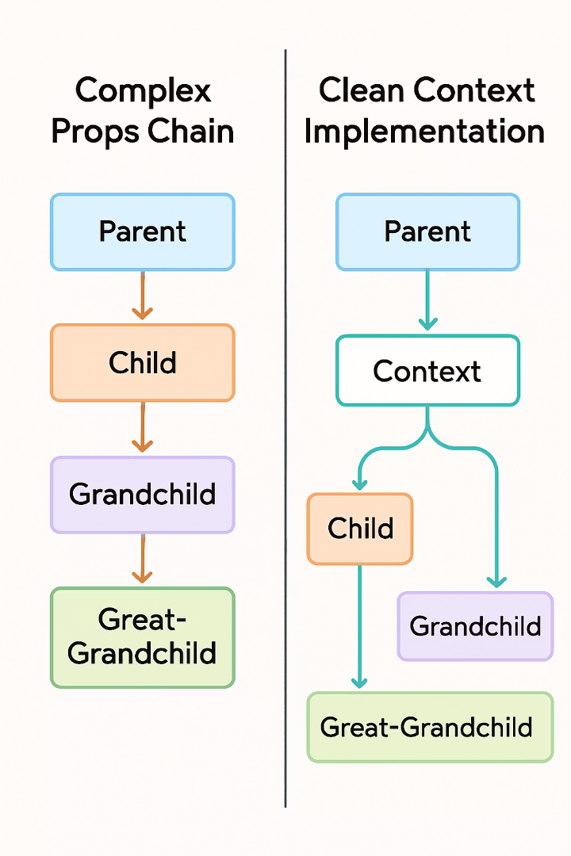




Context API vs. Prop Drilling
Component A
Props: user={user}
Component B
Props: user={user}
Component C
Props: user={user}
Component D
Finally uses user data
With Context API, Component D can access user data directly without intermediate props.

Slide 8
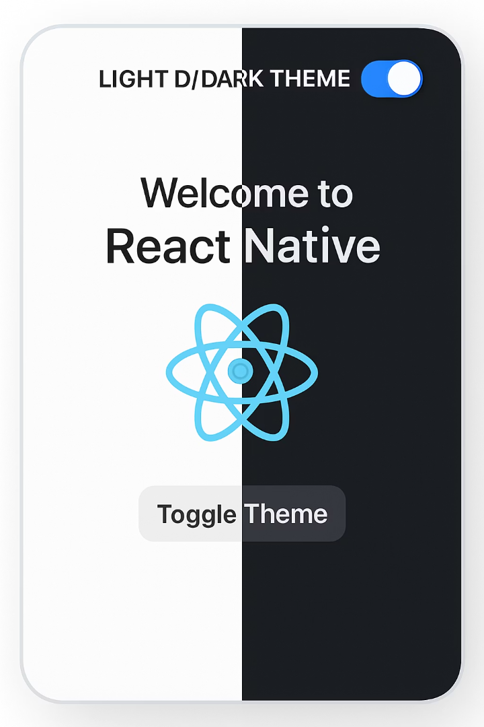
Use Case: Theme Switching
1
2
Create Theme Context
Provide Theme
Define light and dark theme objects
Set up state and toggle function
3
Consume in Components
Apply theme values to styling

Slide 9




Use Case: Authentication
User Credentials
Store login state and user information globally
Protected Routes
Control access to screens based on auth status
Token Management
Handle refresh tokens and session persistence

Slide 10
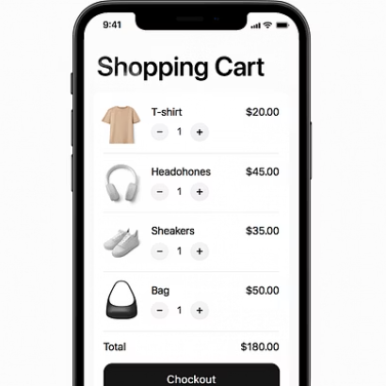
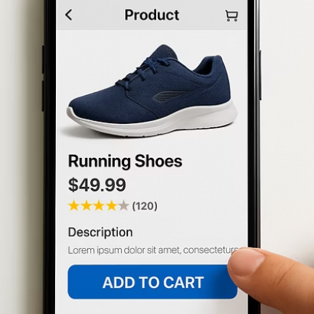
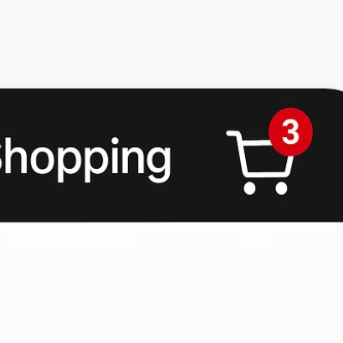
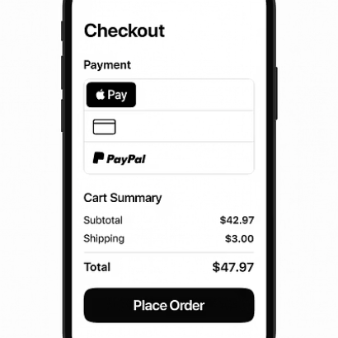
Use Case: Shopping Cart
Cart Items
Add/Remove Functions
Total Calculation
Store in context state
Provide through context
Derived from context data
Context API perfectly handles shopping cart state across all screens of an e-commerce app.

Slide 11
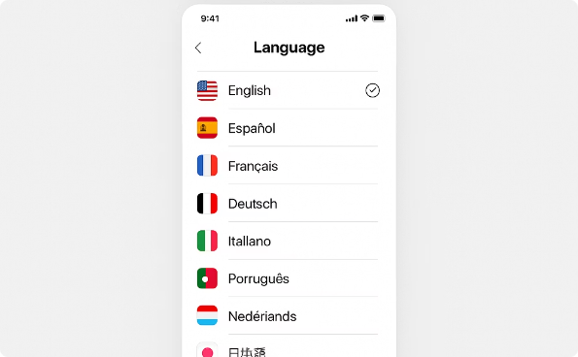
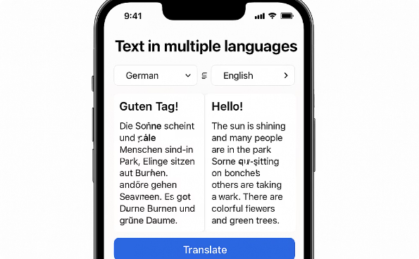
Use Case: Localization
Language Selection
Allow users to choose their preferred language from a settings screen.
Text Translation
Dynamically render UI text based on the selected language.

Slide 12








When NOT to Use Context API
Performance-Critical Parts
Complex State Logic
Redux offers better tools for complex state.
Context triggers widespread re-renders.
Prop Drilling 1-2 Levels
High-Frequency Updates
Props are simpler for shallow component trees.
Not optimized for rapidly changing values.

Slide 13
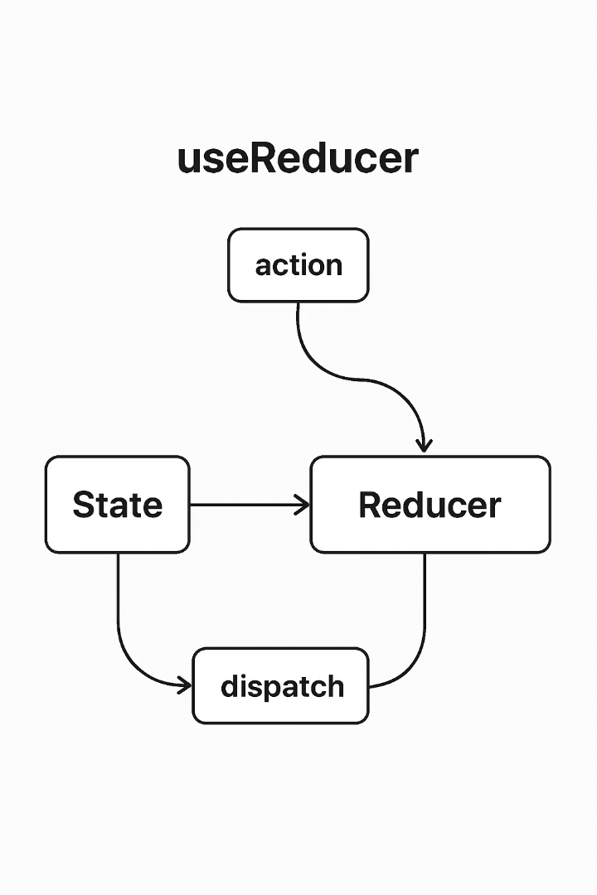
Context + useReducer Pattern: Context Setup with useReducer
//AppContext.js
import React, { createContext, useReducer } from 'react';
const initialState = {
user: null,
theme: 'light',
};
const appReducer = (state, action) => {
switch (action.type) {
case 'UPDATE_USER':
return { ...state, user: action.payload };
case 'TOGGLE_THEME':
return { ...state, theme: state.theme === 'light' ? 'dark' : 'light' };
default:
return state;
}
};
export const AppContext = createContext();
export const AppProvider = ({ children }) => {
const [state, dispatch] = useReducer(appReducer, initialState);
return (
<AppContext.Provider value={{ state, dispatch }}>
{children}
</AppContext.Provider>
);
};

Slide 14
Context + useReducer Pattern: Using Context in a Component
// UserProfile.js import React, { useContext } from 'react'; import { View, Text, Button } from 'react-native'; import { AppContext } from './AppContext'; const UserProfile = () => { const { state, dispatch } = useContext(AppContext); const handleLogin = () => { const userData = { name: 'Alice', email: 'alice@example.com' }; dispatch({ type: 'UPDATE_USER', payload: userData }); }; return ( <View> <Text>User: {state.user ? state.user.name : 'Not logged in'}</Text> <Button title="Login as Alice" onPress={handleLogin} /> </View> ); }; export default UserProfile;

Slide 15
Context + useReducer Pattern: Wrapping App with Provider
// App.js
import React from 'react';
import { AppProvider } from './AppContext';
import UserProfile from './UserProfile';
export default function App() {
return (
<AppProvider>
<UserProfile />
</AppProvider>
);
}

Slide 16
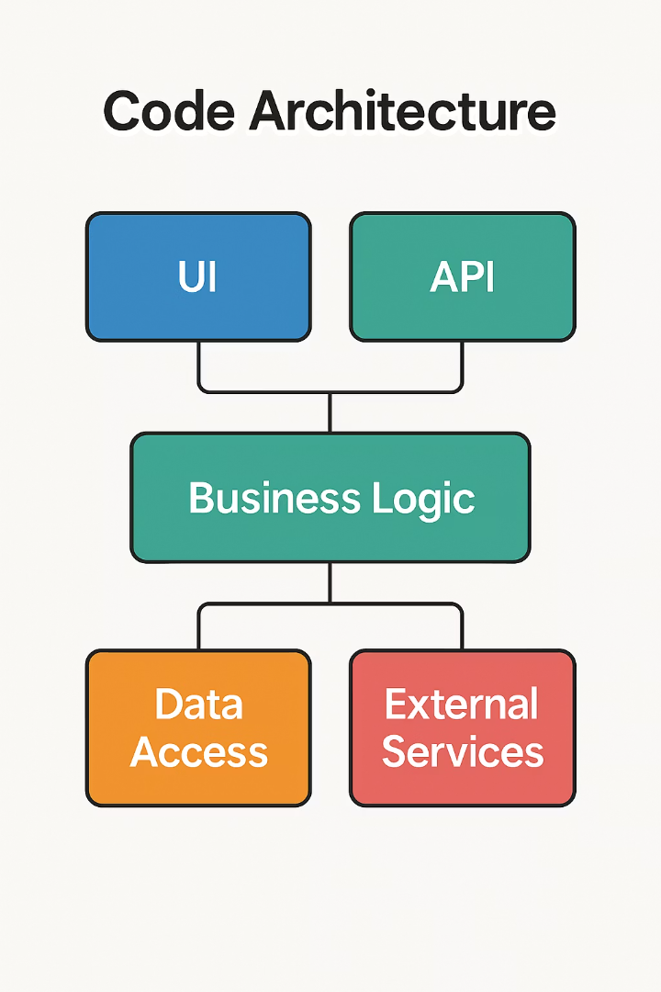
Context API Best Practices
Separate Contexts
Optimized Structure
Create multiple contexts based on domain rather than one global context.
Structure context state to minimize re-renders.
Split frequently changing state
Auth context for user state
UI context for interface state
Use memoization techniques
Data context for app data
Consider context consumers placement
Clear API Surface
Design a clear, consistent API for each context.
Document expected usage
Create helper hooks
Add proper TypeScript types

Slide 17





Common Pitfalls and Solutions
Context Hell
Nesting too many providers creates "Context Hell." Solution: Compose contexts into a single provider component.
Unnecessary Re-renders
All consumers re-render on any context change. Solution: Split contexts and use memoization strategically.
Default Value Confusion
Default context value only used when no provider exists. Solution: Always use providers, even with initial null states.
Complex State Structure
Overly complex context state becomes hard to manage. Solution: Combine with useReducer for clearer state transitions.

Slide 18








Key Takeaways
Master all three Context steps
Create, provide, and consume effectively
Choose the right tool for the job
Context for medium complexity, Redux for complex state
Apply performance optimization techniques
Split contexts and use memoization
Follow established patterns and best practices
Learn from common use cases and avoid pitfalls
Context API is a powerful tool in React Native development. When used appropriately, it simplifies state management and creates cleaner, more maintainable code.

